Slide 1
Snake
Coding a retro videogame

Slide 2
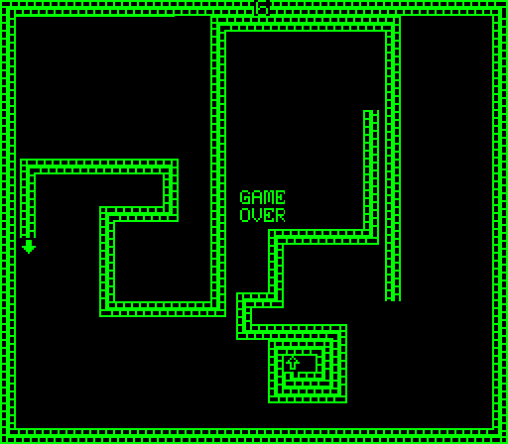
Snake
Snake is a genre of video games, where the player controls a “snake”, that grows as the player continues playing.
The snake itself is the main obstacle of the game, becoming harder to avoid as it grows.
Most notably known for being included on Nokia mobile phones from 1998 onwards
Blockade (1976)

Slide 3
Game components
Representing the game in code

Slide 4
Game components
8x8 grid
snake must remain within the grid
food is placed within the grid
“Snake”
body made of segments,
each segment occupies a grid square
“Food”
a single piece, occupies a random grid square

Slide 5
Game components
8x8 grid
“Snake”
A snake is a list of segments
A segment is a list containing (x, y) coordinates
“Food”
Food is a list containing (x, y) coordinates, like a single worm segment

Slide 6
Game components
8x8 grid
“Snake”
Segment = [4, 6]
Snake[0] = Segment
“Food”
Food = [5, 1]

Slide 7
draw_game()
Outputting the game to the Unicorn HAT

Slide 8
draw_game()
We’ll start with a nearly finished version of the game, and concentrate on outputting the game to Unicorn HAT
Open IDLE 3 (The Blue/Yellow icon on the top bar of the desktop) or a text editor and File → Open:
workshops → 007_snake → 1_drawsnake.py

Slide 9
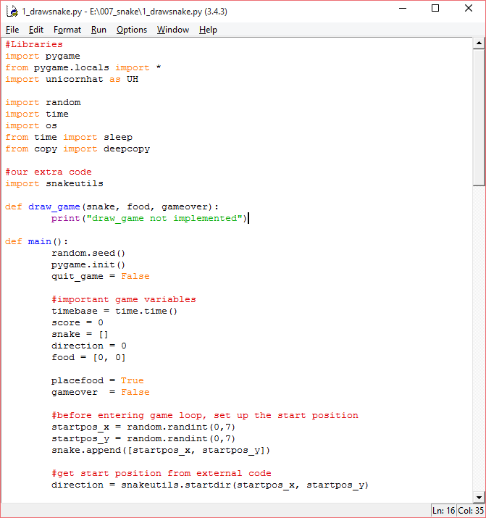
draw_game()

Slide 10
draw_game()
A Function, called draw_game, has been provided to seperate the drawing code from the game code:
def draw_game(snake, food, gameover):
print("draw_game not implemented")

Slide 11
draw_game()
Drawing the Food

Slide 12
draw_game()
Remember that food is a list with 2 coordinates, so we just have to retrieve these two values from the list.
Try typing this into the Python Shell window:
>>> pixel = [5,7] #Storing some coordinates
>>> pixel[0] #Retrieving X coordinate
5
>>> pixel[1] #Retrieving Y coordinate
7

Slide 13
draw_game()
The functions for Unicorn HAT are:
To draw food, copy:
UH.set_pixel(x, y, R, G, B)
UH.show()
#draw food
UH.set_pixel( )
UH.show()

Slide 14
draw_game()
The functions for Unicorn HAT are:
To draw food, copy:
UH.set_pixel(x, y, R, G, B)
UH.show()
#draw food
UH.set_pixel(food[0], food[1], 100, 100, 100)
UH.show()

Slide 15
draw_game()
Drawing the Snake

Slide 16
draw_game()
a loop for each piece of the snake:
#draw snake
for i in range(0, len(snake)):
UH.set_pixel( , ,
100, 100, 100)

Slide 17
draw_game()
A segment is a list, so a snake is a list of lists:
>>> snake[0]
[5, 7]
>>> snake[0][0]
5
>>> snake[0][1]
7

Slide 18
draw_game()
to draw each piece of the snake, copy:
#draw snake
for i in range(0, len(snake)):
UH.set_pixel(snake[i][0], snake[i][1],
100, 100, 100)

Slide 19
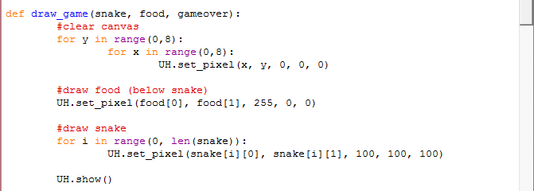
draw_game()

Slide 20
draw_game()
Fixing a bug

Slide 21
draw_game()
The snake seems to keep growing, this is because our new snake gets drawn on top of our old snake, we need to clear the screen before drawing the new snake and food
Add this before the snake and food draws (the start of the function):
#clear screen
for y in range(0, 8):
for x in range(0, 8):
UH.set_pixel(x, y, 0, 0 , 0)

Slide 22
draw_game()
Something to try:
a third parameter, “game_over”, is a Boolean (True/False) value. The game shouldn’t be drawn when gameover is true, so use an if/else to stop the game being drawn.

Slide 23
draw_game()
Everything completed:
#if the player has lost, don't draw the game
if gameover:
for y in range(0,8):
for x in range(0,8):
UH.set_pixel(x, y, 50, 0, 0)
else:
#clear canvas
for y in range(0,8):
for x in range(0,8):
UH.set_pixel(x, y, 0, 0, 0)
#draw food (below snake)
UH.set_pixel(food[0], food[1], 255, 0, 0)
#draw snake
for i in range(0, len(snake)):
UH.set_pixel(snake[i][0], snake[i][1], 100, 100, 100)

Slide 24
draw_game()
We’re ready to play the complete game:
Unicorn HAT required ‘superuser’ access, so we have to launch our program through the terminal

Slide 25
draw_game()
Running the game

Slide 26
draw_game()
Open a terminal (the black monitor icon at the top of the desktop), and type:
pwd will show your current ‘directory’ (folder), ls will list all files and directories in the current directory.
will move to the folder with our python script, you can run ls again to see your scripts
$ pwd
$ ls
$ cd workshops/007_snake

Slide 27
draw_game()
Finally, run the script with:
$ sudo python3 1_drawsnake.py

Slide 28
Everything else
Diving into the main game code

Slide 29
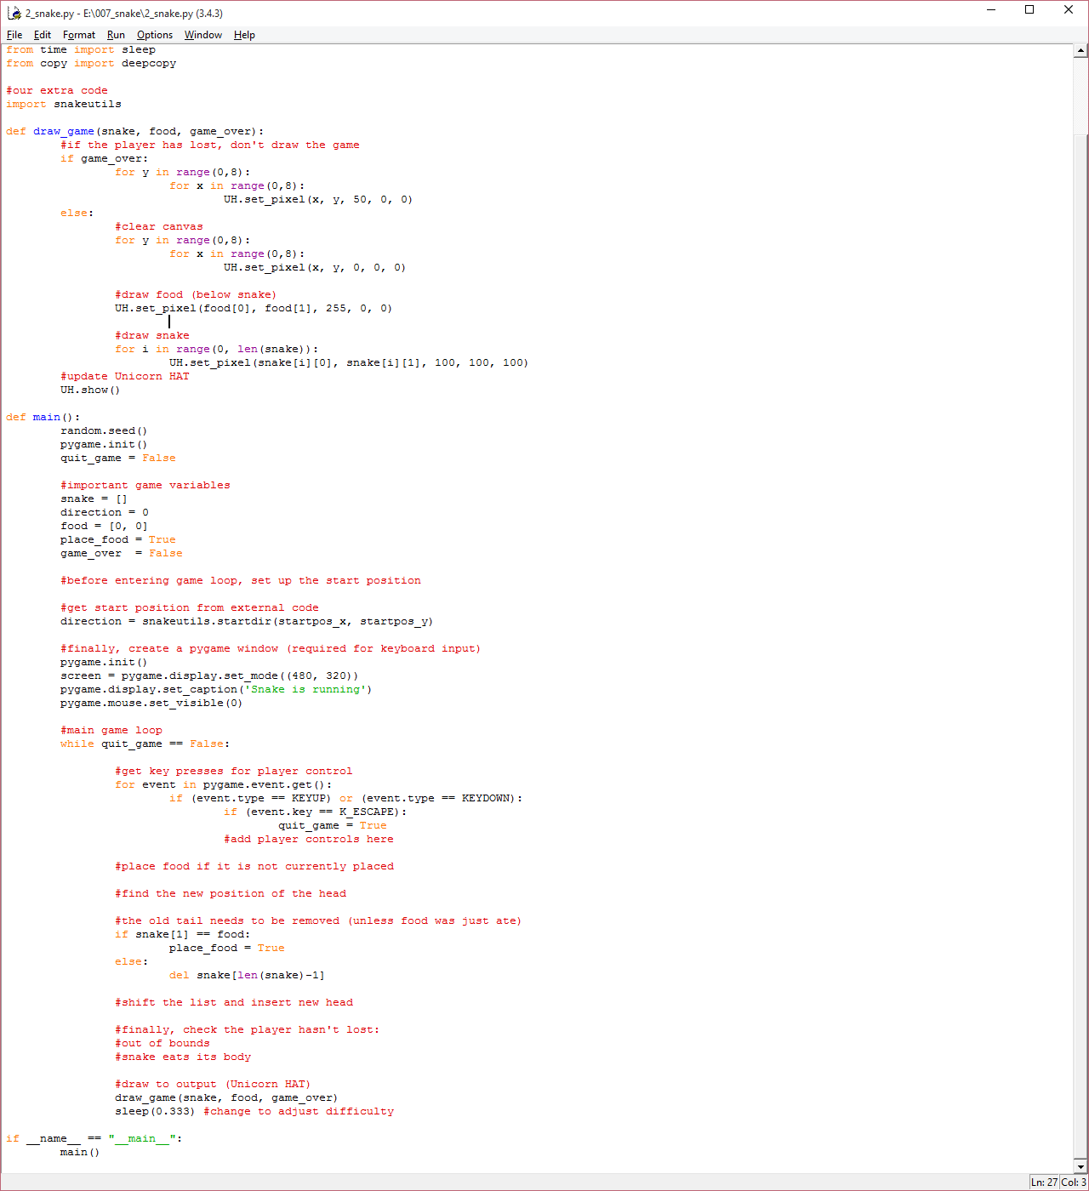
Everything else
File → Open:
workshops → 007_snake → 2_snake.py

Slide 30
Everything else
Looks scary, but don’t panic!
The code is split into two main parts

Slide 31
Everything else

Slide 32
Everything else

Slide 33
The Full Game
startup code

Slide 34
The Full Game
Lets look at the game variables:
snake - the snake list
food - the food position
direction - the player's current direction (arbitrary number)
place_food - food will be placed if true
game_over - game will stop when true

Slide 35
The Full Game
The only bit of code that needs to be added outside of the main game loop is to place the snake. This is done randomly
Insert this code, which picks a random x and y coordinate, and adds a snake segment to the (empty) list:
#before entering game loop, set up the start position
startpos_x = random.randint(0,7)
startpos_y = random.randint(0,7)
snake.append([startpos_x, startpos_y])

Slide 36
The Full Game
Main loop

Slide 37
The Full Game
The main game loop contains everything that updates throughout the game, it continues until the game is exited
If an arrow key (WASD) was pressed, the direction is changed
if place_food is true, place food
the snake is moved according to the player direction
if the snake moved into food, set place_food to true for next turn
check the game over conditions

Slide 38
The Full Game
⅕ - Controls

Slide 39
The Full Game
The key press code only accepts one key at present, which exits the game. To give the player control of the character, we must add the rest.
Add this code:
if (event.key == K_ESCAPE):
quit_game = True
if (event.key == K_w):
direction = 0
if (event.key == ):
direction =
...

Slide 40
The Full Game
#get key presses for player control
for event in pygame.event.get():
if (event.type == KEYUP) or (event.type == KEYDOWN):
if (event.key == K_ESCAPE):
quit_game = True
if (event.key == K_w):
direction = 0
elif (event.key == K_d):
direction = 1
elif (event.key == K_s):
direction = 2
elif (event.key == K_a):
direction = 3

Slide 41
The Full Game
⅖ - Place food

Slide 42
The Full Game
The code for the food is a little complicated, as it can’t be placed on top of the snake. A function has been written for you in snakeutils.py, you can take a look at how it works there.
You simply need to Add this code:
#place food if it is not currently placed
if place_food == True:
food = snakeutils.place_food(snake)
place_food = False

Slide 43
The Full Game
⅗ - Snake movement

Slide 44
The Full Game
Snake movement is a little harder, so let’s break it down:
Add the new head, based on the player direction
remove the old tail, so it looks like the snake has moved
unless food has been ate, so the snake “grows”

Slide 45
The Full Game
Because the direction values are arbitrary, this is handled by another function in snakeutils.py. (Whiteboard)
Copy this code:
deepcopy() is an oddity of python, copies a list to a separate variable.
headpos = snake[0] does not work!
#find the new position of the snake
head_pos = deepcopy(snake[0])
head_pos = snakeutils.movement(head_pos, direction)

Slide 46
The Full Game
We need to add the new head to the start of the list, but python only has a function for adding to the end. We can cheat by reversing the list twice
Use this code:
#shift the list and insert new head
snake.reverse()
snake.append(head_pos)
snake.reverse()

Slide 47
The Full Game
⅘ - Snake movement (Part 2)

Slide 48
The Full Game
This code was accidentally left in on purpose, and also has an accidental error, to make sure you’re paying attention.
Observe and modify this code:
#the old tail needs to be removed (unless food was just ate)
if snake[0] == food:
place_food = True
else:
del snake[len(snake)-1]

Slide 49
The Full Game
5/5 - Detecting a game over

Slide 50
The Full Game
There are two ways to lose snake:
run off the edge of the grid
the snake eats part of its own body

Slide 51
The Full Game
Running the final game

Slide 52
The Full Game
as before:
Errors are likely! just ask for help
$ sudo python3 2_snake.py

Slide 53
The Full Game
Ideas for expansion

Slide 54
The Full Game
Now the main game has been completed, adding additional features should be more straightforward. Here are a few ideas:
Scoring - Add your own scoring system back into the game
(an idea: speedrunning rules, quickest to 20 dots?)
Chemistry - Make the food change colour every loop. (food[2] = a number, each number is a colour?)
Rainicorn - Give each segment of the snake a different colour
(more difficult, you’ll need to shift the colour along the list)

